Slide 1
Object Oriented Programming Lab CSE 1206
Lab 3

Slide 2
Access Modifier: public
 | public
Class | Yes
Fields/ variables | Yes
Methods | Yes
Constructors | Yes

Slide 3
Task:
Create a Project Named: ShapeDemo
Create a new class within the same package named: Circle
Declare two public variables:
radius : double
color : String
Declare a default empty constructor.
Declare another constructor and pass parameters as (double radius, String color)
Create a method named calculateArea() which return the area in datatype double.
For value of PI use= Math.PI

Slide 4
Task:
In the ShapeDemo class Declare an object of Circle class.
Assign values radius = 12 , color =“green” using constructors.
Call the method calculateArea() using the object.
Print the color variable and the area.
Assign value of color =“blue” using the object to the variable color and print it.

Slide 5
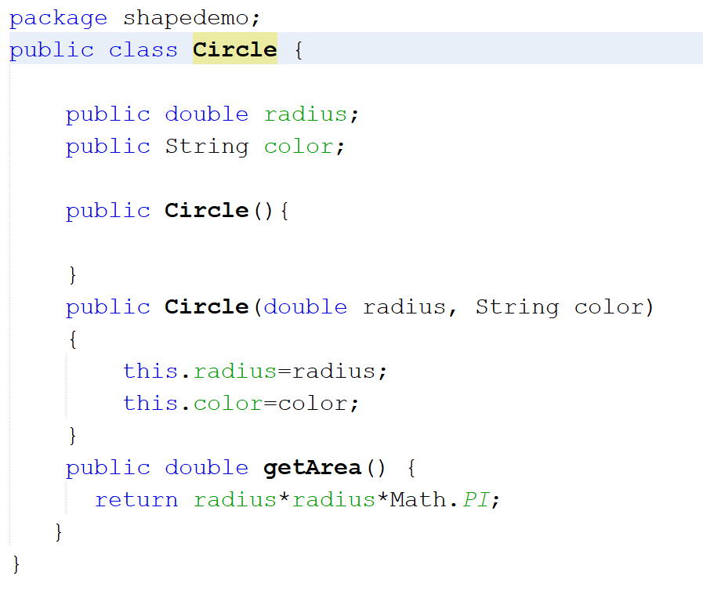

Slide 6
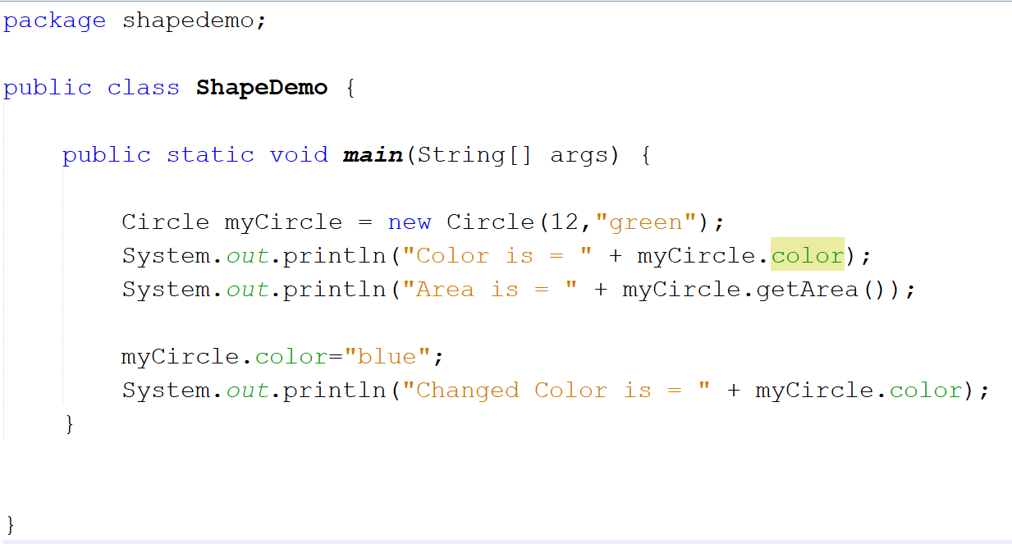

Slide 7
Methods in Java

Slide 8
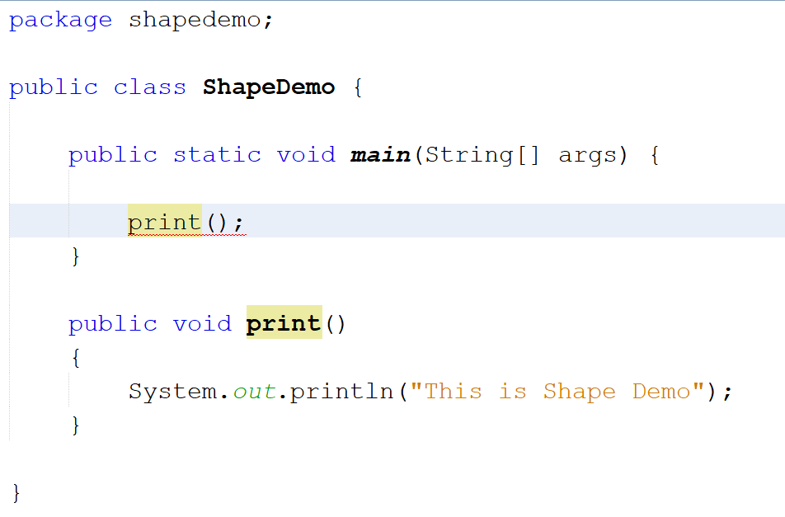
Giving an error.

Slide 9
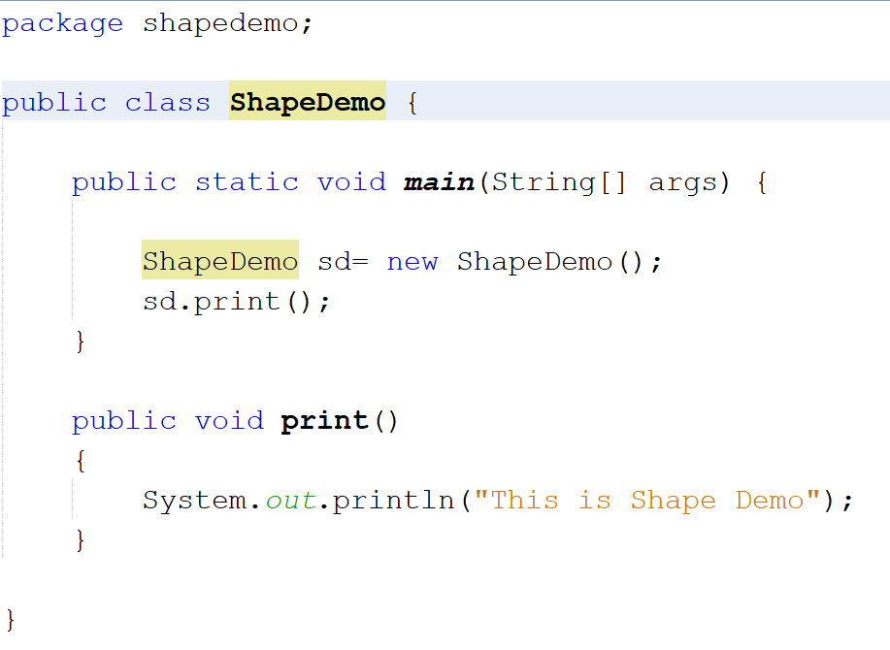

Slide 10
static Keyword
If we want to access a class member (variables, methods) in Java, we must first create an object of the class.
static keyword can be used to access class members without creating objects.

Slide 11
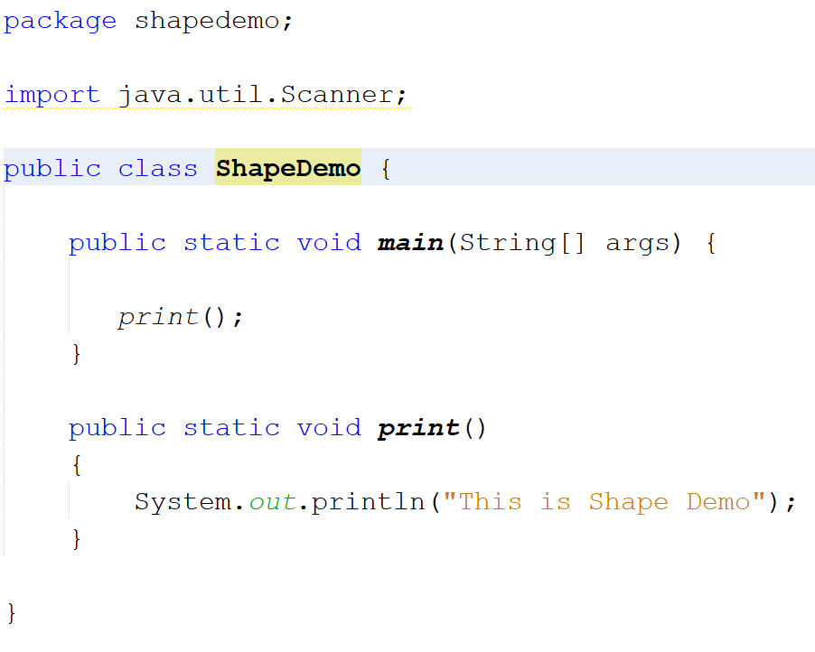

Slide 12
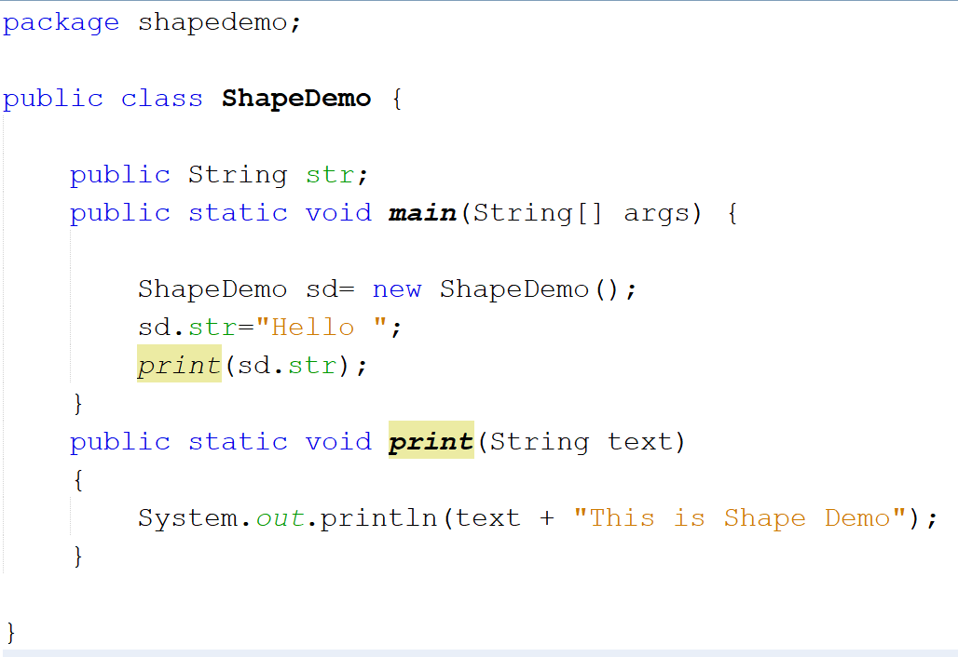

Slide 13
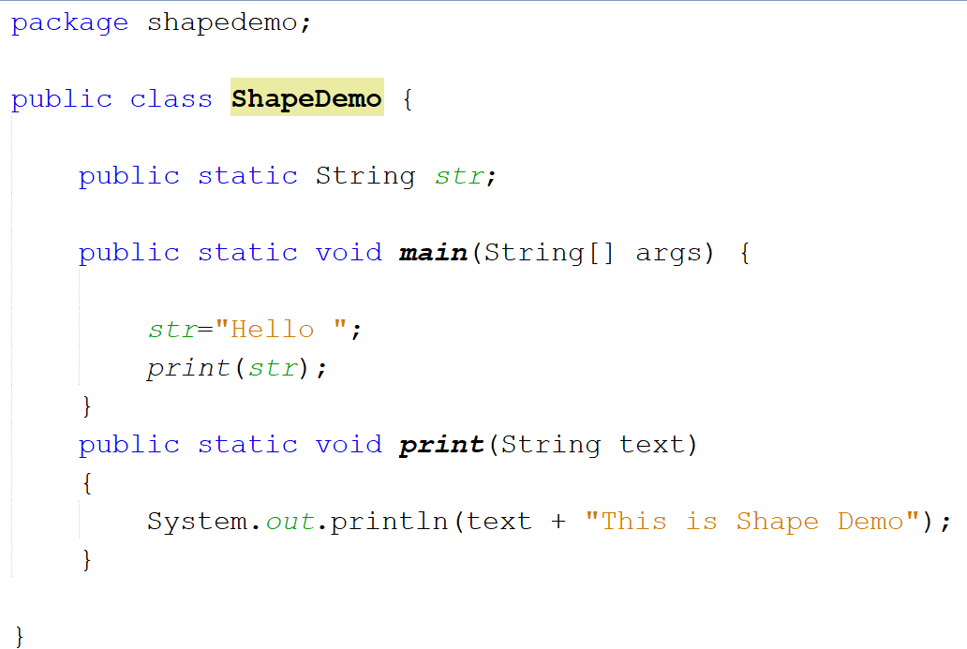

Slide 14
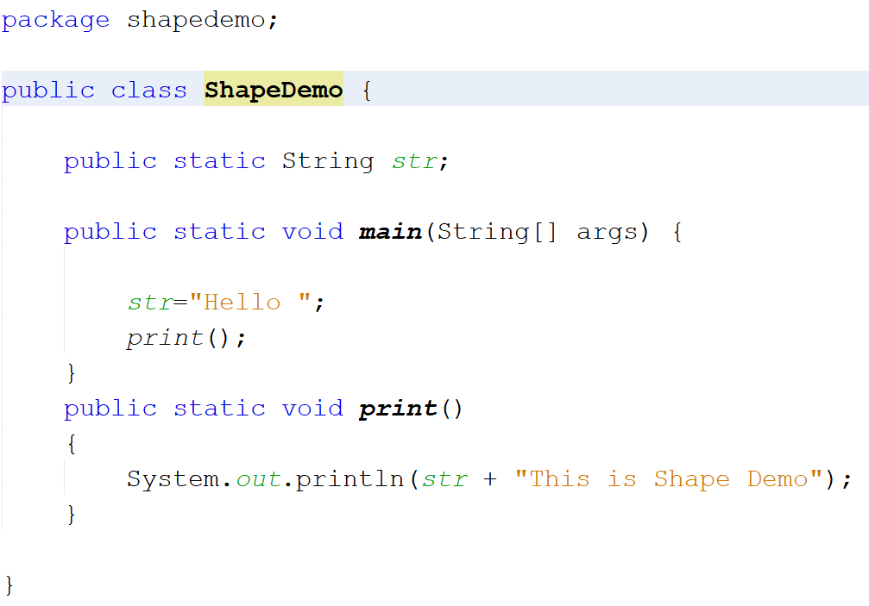

Slide 15
If both variable and method are not declared static then the variable can be accessed by the non-static method without creating an object.

Slide 16
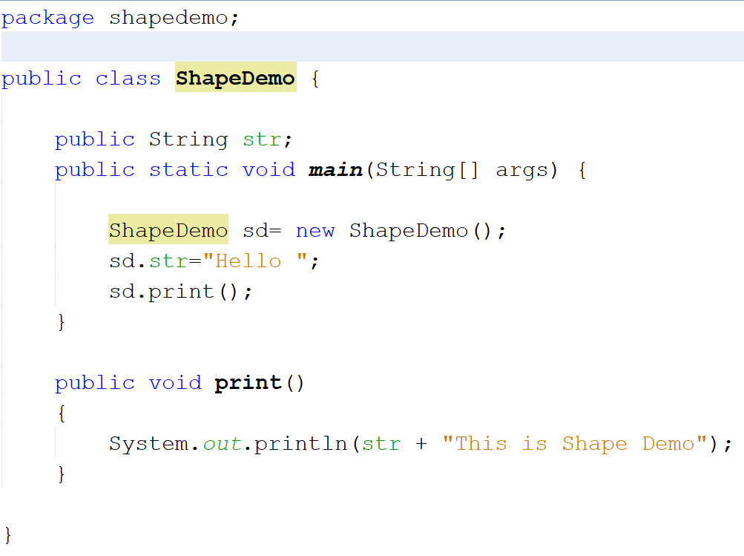

Slide 17
Access Modifier: private
 | private
Class | Mostly NO (can be declared in some cases)
Fields/ variables | Yes
Methods | Yes
Constructors | Yes

Slide 18
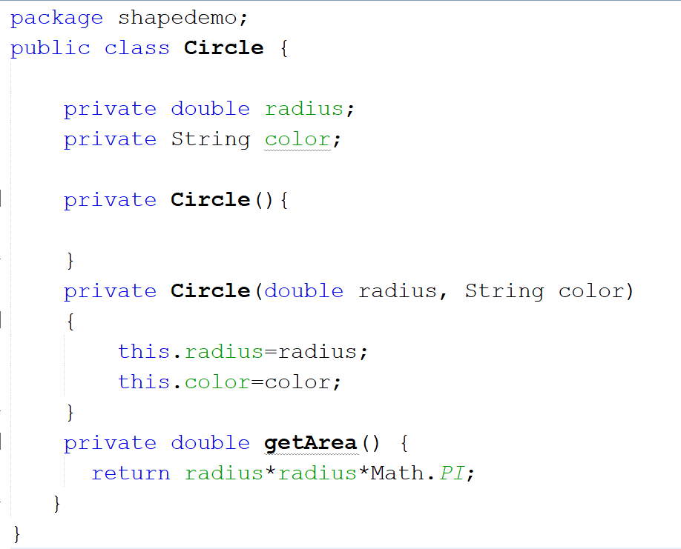
Will Give Error in ShapeDemo
when object is created.
Because Private constructors,
methods and variables
are not accessible.

Slide 19
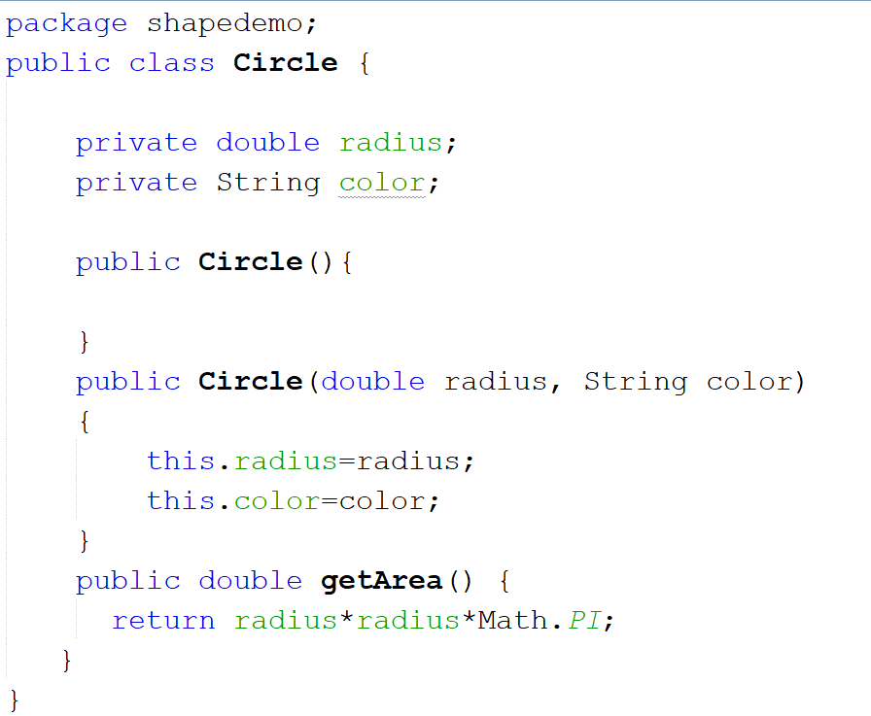

Slide 20
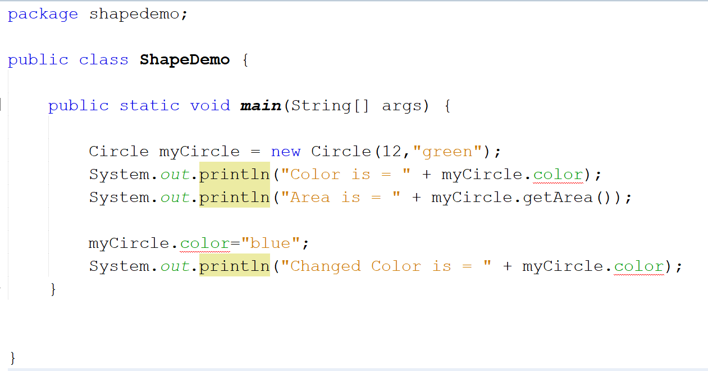
Private variable Color accessed
but gives error

Slide 21
Solution: Getter and Setter

Slide 22
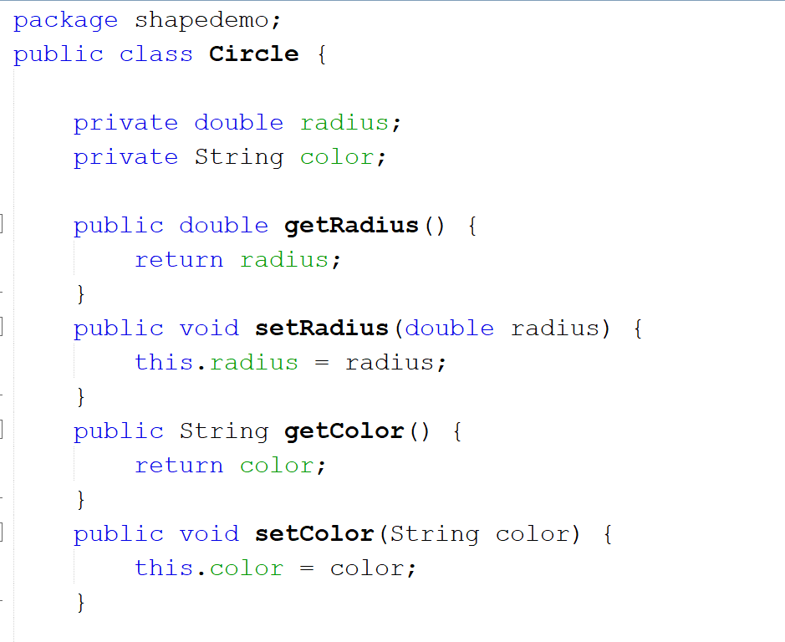

Slide 23
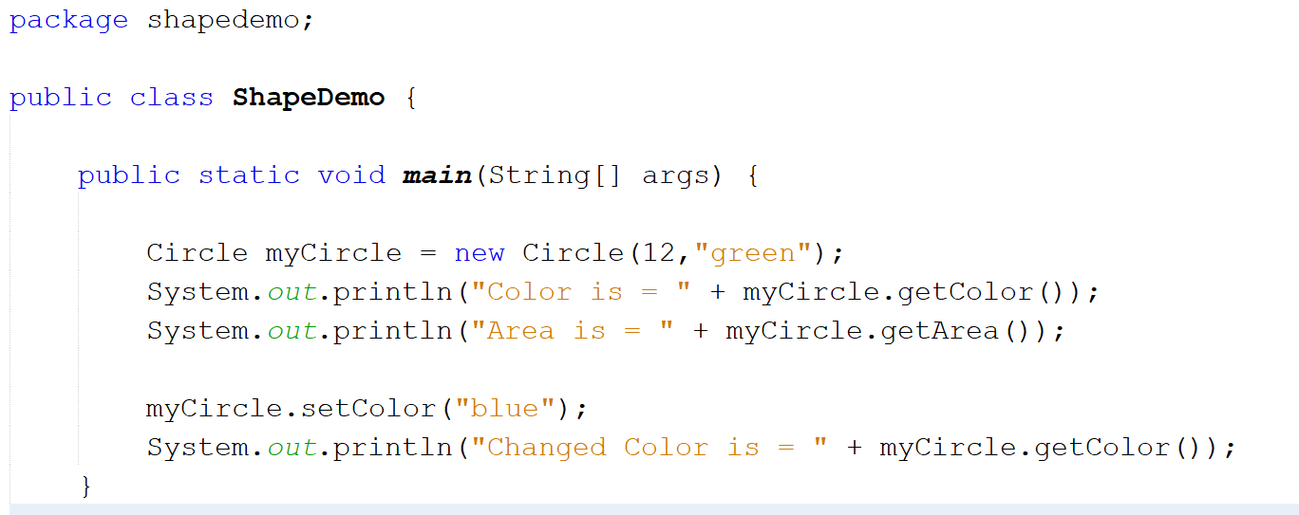

Slide 24
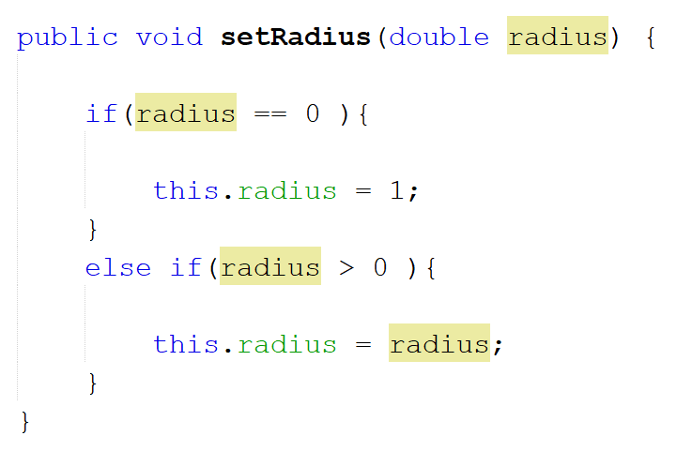

Slide 25
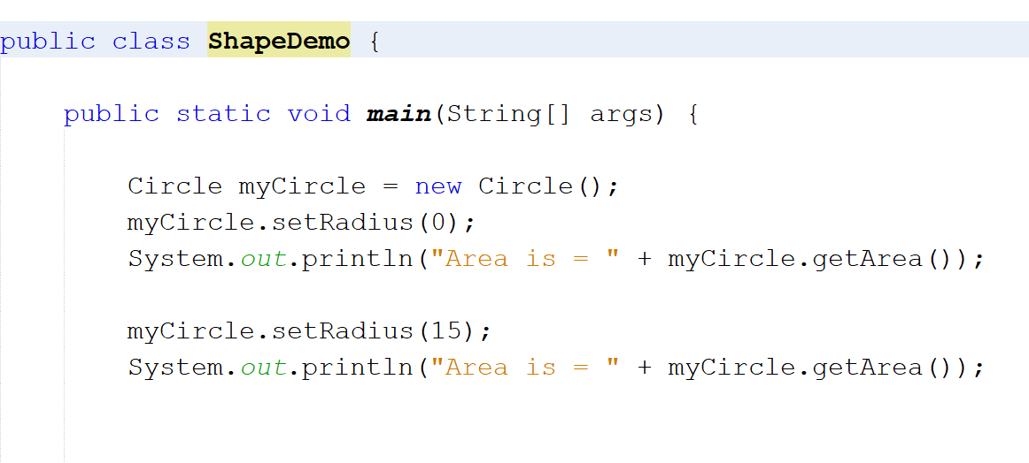

Slide 26
Objects As Parameters in Methods

Slide 27
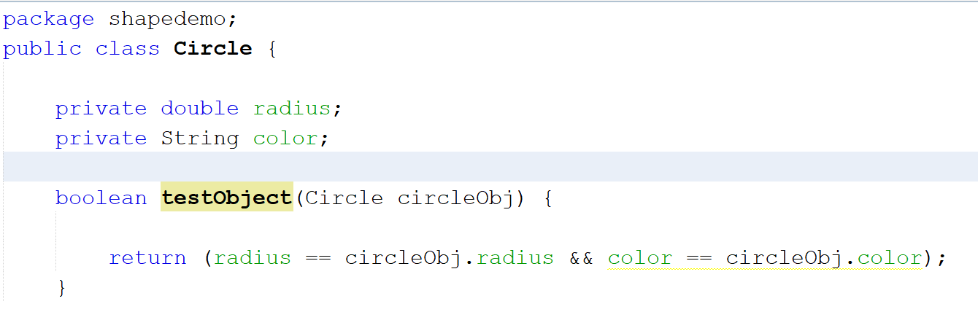

Slide 28
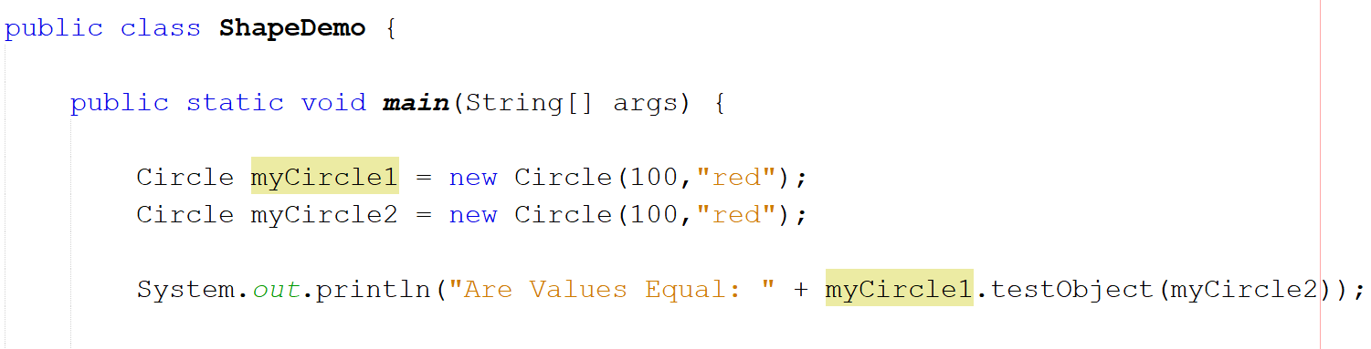

Slide 29
Objects As Return Types in Methods

Slide 30
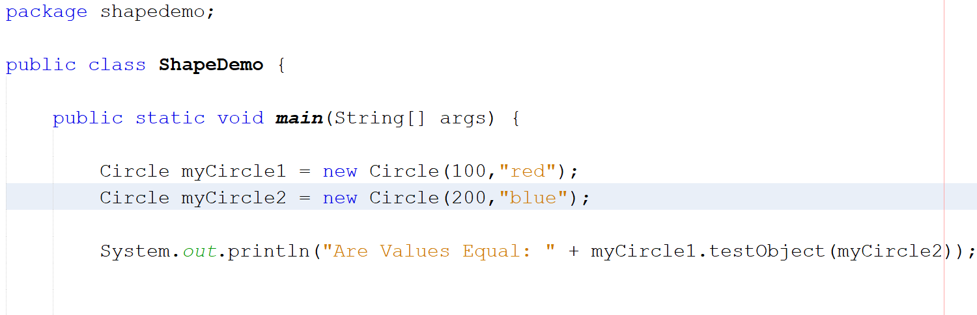

Slide 31
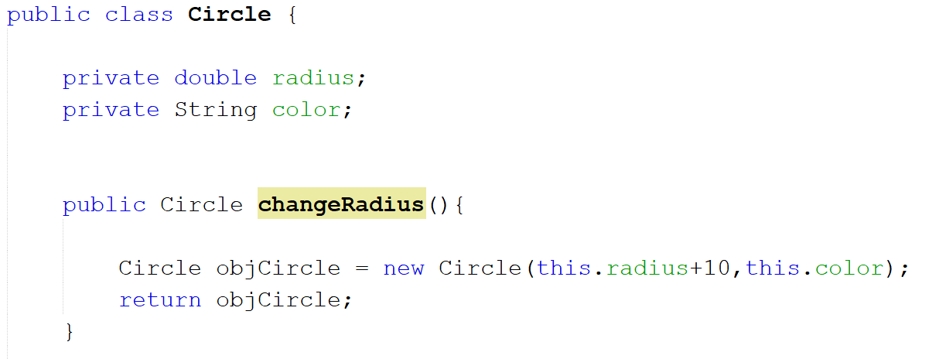

Slide 32
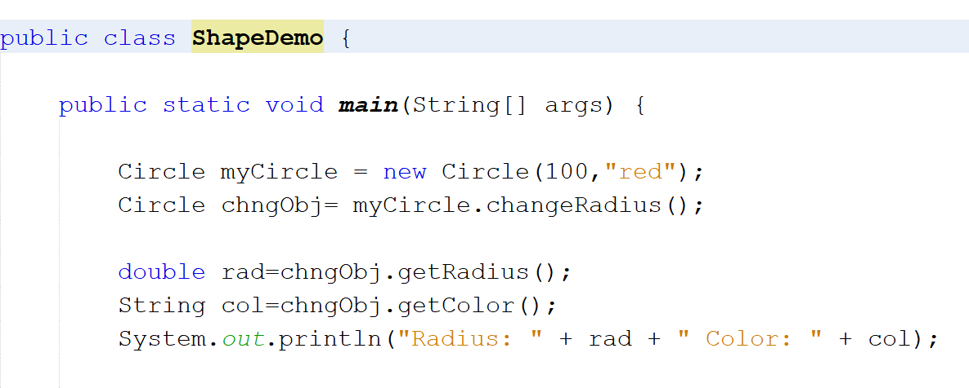

Slide 33
Practice Problem

Slide 34
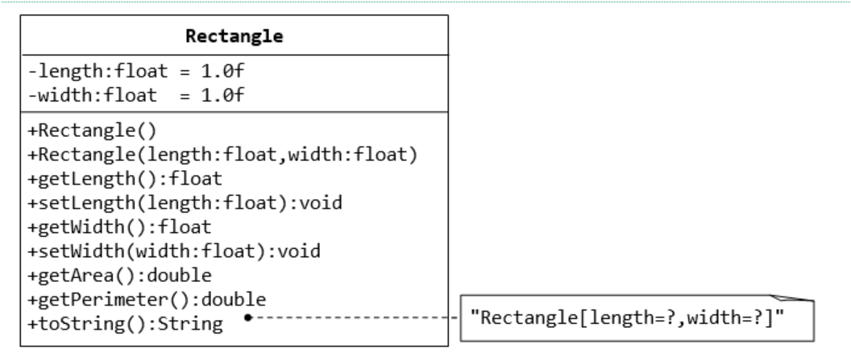
public String toString() {
return “Rectangle[length=" + length + " width=" + width + "]";
}

